Slide 1

Green Pace
Security Policy Presentation
Developer: Tristin Watson

Slide 2

OVERVIEW: DEFENSE IN DEPTH
Layered defenses are a must have for software security but how many layers are truly necessary to maintain a stable defense for your software. From the video on DiD called “Cyber Security Minute: How does defense in depth work?”, the main defensive layers are Patches, Anti-Virus, Firewall, and IPS. In the video, the narrator explains that each basic layer has their own vulnerabilities in different sections but do not overlap each other. This means that while one layers vulnerability might be used against it, the next layer will be able to block said vulnerability. This in turn allows the layers to create one cohesive whole with little to no security cracks. (Training 2017)
Notes:
You can still add more layers to this process to keep your software even more secure but when are there too many layers? This really comes down to the assets you wish to protect along with the time, capital, and man-power you wish to fork out the protect those assets. While some if not every additional layer can be automated, the effort and money needed to make said layer automated can be vast. The company wishing to secure their information must decide how many layers feel right to not bankrupt them but still feel secure in the long run. (Yendamury 2021)
DiD uses AES algorithms to help authenticate user credentials. This makes those with nefarious intention require a key to gain access to data. There is also a randomization to the encryption which makes attacking the system even more difficult. This is the way DiD uses multiple layers to succeed in forming a tight nit net to defend against attacks of all kinds. One other unique feature of DiD is logic locking. Logic locking uses the known vulnerabilities to ensure that correct outputs are performed. (Yendamury 2021)

Slide 3
10 PRINCIPLES
Validate Input Data
Heed Compiler Warnings
Architect and Design for Security Policies
Keep It Simple
Default Deny
Adhere to the Principle of Least Privilege
Sanitize Data Sent to Other Systems
Practice Defense in Depth
Use Effective Quality Assurance Techniques
Adopt a Secure Coding Standard(sei.cmu)
Notes:
1. Validate Input Data
Validating user input allows programmers to ensure that only the set parameters are allowed in their program. SQL injections are put to a near immediate stop with just validating the user input. It also restricts buffer overflows through limiting the amount of characters a user is allowed to input.
2. Heed Compiler Warnings
Compiler warnings let programmers know where a potential problem might lie and fix it early. Eliminating security flaws is a must in any software program if you wish to keep it secure.
3. Architect and Design for Security Policies
Design your system with security in mind. To keep your software safe, place privilege settings at different intervals and divide your system based on these privileges to ensure that your data is safe.
4. Keep It Simple
Although easy on paper, keeping your software simple is a much harder task to actually do. Modularize your code and keep it organized. Messy code is a huge security flaw in and of itself.
5. Default Deny
Deny access by default. This means you only need to validate the users credentials and keeps a random unknown loophole from becoming your downfall.
6. Adhere to the Principle of Least Privilege
Set privileges from least to greatest in structure. This means hackers must breach each and every set of the structure to gains full access to your system and keeps what they manage to get to a minimum otherwise.
7. Sanitize Data Sent to Other Systems
Any data passed through your system must be sanitized. Injection attacks are commonplace and an easy way to avoid such attacks is to identify/restrict them at the start.
8. Practice Defense in Depth
Multiple defensive measures are a must have for any software. While one defense measure might be a specific flaw, the other measures do not and cover of said flaw later. This allows your overall security to be structurally sound against any common attack out there.
9. Use Effective Quality Assurance Techniques
Quality assurance is a must use in any software system. Ensuring that your code is neat and secure keep vulnerabilities to a minimum. It also allows for vulnerabilities to be found sooner rather than later when such a problem does occur.
10. Adopt a Secure Coding Standard
Coding standards allow for your code to be clean and modularized. Clean code can be used later without much difficulty while messy code needs to first be fixed and error checked. Applying coding standards can keep your software secure through simple steps that allow for identifying mistakes later on.

Slide 4
CODING STANDARDS
Unsigned Integers must not wrap
Integer Precision Correctness
Do Not Modify String Literals
Valid String Format
Freed Memory Must Not be Accessed
Behavior Of Assert() and Abort() Termination
Handle All Exceptions
Floating-point Should Be In Range of New Data Type
Declare Identifiers
Array Size Argument Must Be Within Range (sei.cmu)
Notes:
Unsigned Integers must not wrap - Validate Input. The code above ensures that if an integer can surpass the data limit, then the error is handled.
Integer Precision Correctness - Input Validation. The code block above ensures that even for unique scenarios, the precision is correct.
Do Not Modify String Literals - Secure Coding Standard. Accessing an array is much more secure than modifying a string literal.
Valid String Format - Secure Coding Standards. Correctly formatting strings ensures that your code is secure.
Freed Memory Must Not be Accessed - Adopt Secure Coding Standards. Do not access freed memory since it could cause errors in your program.
Behavior Of Assert() and Abort() Termination - Heed Compiler Warnings. Asserts are compiler warnings which should be addressed if flagged.
Handle All Exceptions - Use Effective Quality Assurance Techniques. Handling all exceptions is integral to making your code secure.
Floating-point Should Be In Range of New Data Type - Input Validation. Ensuring floats are in range of new data types keeps overflows from happening.
Declare Identifiers - Use Effective Quality Assurance Techniques. Declaring identifiers helps keep code clean.
Array Size Argument Must Be Within Range - Input Validation. The code block above handles errors if the array size will surpass the specified range.

Slide 5
THREATS MATRIX (sei.cmu)
Rule | Severity | Likelihood | Remediation Cost | Priority | Level
STD-001-CPP | High | Unlikely | Medium | High | 2
STD-002-INT | Low | Unlikely | Medium | P2 | L3
STD-003-STR | Low | Likely | Low | P9 | L2
STD-004-FIO | High | Unlikely | Medium | P6 | L2
STD-005-MEM | High | Likely | Medium | P18 | L1
STD-006-ERR | Medium | Unlikely | Medium | P4 | L3
STD-007-ERR | Low | Probable | Medium | P4 | L3
STD-008-FLP | Low | Unlikely | Low | P3 | L3
STD-009-DCL | Low | Unlikely | Low | P3 | L3
STD-010-ARR | High | Probable | High | P6 | L2

Slide 6
ENCRYPTION POLICIES (sei.cmu)
Encryption | Explain what it is and how and why the policy applies.
Encryption in rest | Used to securing data stored on a physical disk. Encrypting data stored on a disk keeps even physically stolen data from being used.
Encryption at flight | Used to secure data during its move throughout a network. As data flows through a network, encrypting it keeps the data from being stolen.
Encryption in use | Encrypts data during usage to maintain secure data transfer. Using this method keeps in use data from being stolen.

Slide 7
TRIPLE-A POLICIES (sei.cmu)
Triple-A Framework | Explain what it is and how and why the policy applies.
Authentication | Authentication is used to ensure that a user is who they say they are. This policy is used to secure each account for users.
Authorization | Authorization is used to check whether a user is allowed to access the specific content they are trying to access.
Accounting | Accounting is used to track what users do while on your program. You can account for a user’s footprint to make sure they are not performing any nefarious deeds.

Slide 8
Unit Testing
Unit Testing is a must to ensure your methods are working as intended.
The next few slides are different examples of unit tests.

Slide 9
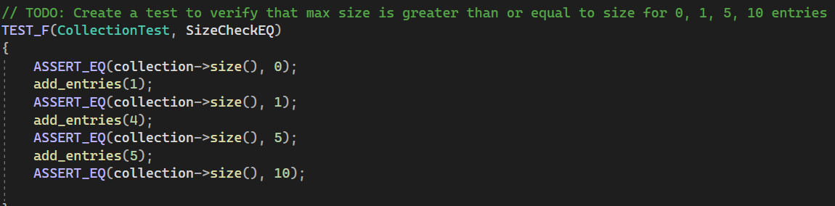
Unit Test #1
This first test asserts whether entries can be added to a collection.

Slide 10
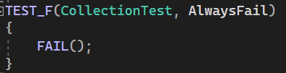
Unit Test #2
This unit test ensures that failure is possible on a test.

Slide 11
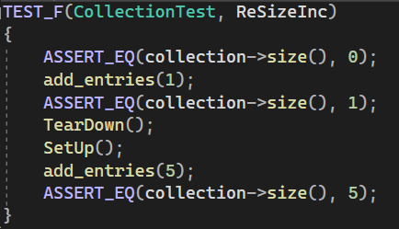
Unit Test #3
This unit test checks if a collection can be resized.

Slide 12
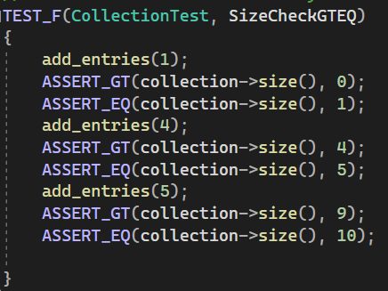
Unit Test #4
This last test ensures that you can check for greater or equal to collections.

Slide 13

AUTOMATION SUMMARY

Slide 14
TOOLS
The DevSecOps pipeline is setup into a few different sections. These sections are
Threat Modeling – Models risks for software.
Security Testing – Tests code for errors.
Security Analysis – Scans for vulnerabilities.
Remediation – Addresses vulnerabilities.
Monitoring – Monitors for new risks and threats.
There are several different tools that can be used to accomplish the DevSecOps pipeline. These tools are:
Static Tests – displays common vulnerabilities.
Dynamic Tests – Tests issues during application runtime.
Vulnerability scans – Detects vulnerabilities that are less common.
Source Analysis – Identifies dependencies and libraries. (Michali, 2022)

Slide 15
RISKS AND BENEFITS
Problems with lacking Defense in Depth:
Easily accessible database for hackers
Less security
Legal issues
Benefits of lacking Defense in Depth:
Save money (short term)

Slide 16
RECOMMENDATIONS
The automation and security of a program should be done during the entire cycle of production. This includes pre-production since planning for a secure program is a must do process. There are numerous ways to develop a secure program but doing it during production allows for you to save money, time, and also ensures there are not any forgotten and unsecured items in the program.

Slide 17
CONCLUSIONS
Standards that must be adopted to stay secure include:
Input Validation
Handle All Exceptions
Floating-point Should Be In Range of New Data Type
Array Size Argument Must Be Within Range
These standards keep code clean and error free while also keep data sanitized and up-to-date.

Slide 18
REFERENCES
G. Yendamury and N. Mohankumar, "Defense in Depth approach on AES Cryptographic Decryption core to Enhance Reliability," 2021 IEEE International IOT, Electronics and Mechatronics Conference (IEMTRONICS), Toronto, ON, Canada, 2021, pp. 1-7, doi: 10.1109/IEMTRONICS52119.2021.9422567.
Training, D. (2017, January 23). Cyber security minute: How does defense in depth work?. YouTube. https://www.youtube.com/watch?v=lnIRqw0jutA
safeonline. (2018, March 12). Secure coding practices: Digital security guide: Safeonline.ng : Digital Security Guide. Digital Security Guide | Safeonline.ng. https://safeonline.ng/web-developers/secure-coding-practices/
sei.cmu. (n.d.). SEI CERT C Coding Standard. SEI CERT C Coding Standard - SEI CERT C Coding Standard - Confluence. https://wiki.sei.cmu.edu/confluence/display/c/SEI+CERT+C+Coding+Standard
Michali. (2022, September 15). What is a DevSecOps pipeline?. Check Point Software. https://www.checkpoint.com/cyber-hub/cloud-security/devsecops/what-is-a-devsecops-pipeline/

